Slide 1
Savanna
By: Taylor Giles
Jaskiran Saini
Eva Stebel

Slide 2
What is a Savanna?
A Savanna is a grassland region with scattered trees, grading into either open plain or woodland.
It is usually located in subtropical or tropical regions.

Slide 3
Worldwide Location
Africa: Countries- Guinea, Sierra Leone, Liberia, Cote D’ivorce, Ghana, Togo, Benin, Nigeria, Cameroon, Central African Republic, Chad, Sudan, Ethiopia, Somalia, Democratic Republic of the Congo, Angola, Uganda, Rwanda, Burundi, Kenya, Tanzania, Zimbabwe, Zambia, Mozambique, and Botswana
South America: Countries- Brazil, Colombia, Venezuela
Northern Australia: From Broome to Townville
Asia/India:*Savannas occupy about 2.5 square kilometers(0.97 square miles)*
Latitude(Brazil): 3 S 25 S
Latitude(Colombia and Venezuela) : 2 N 8 N
Latitude: 15 N 30 S
Latitude: 20 S 35 S
Latitude: 11 N 25 N

Slide 4
Average Climate
Temperature- It is usually cooler during the dry season by a few degrees. Because it is in the tropical latitudes that is still hot enough. The savanna climate has a temperature range of 68° to 86° F (20° - 30° C). In the winter, it is usually about 68° to 78° F (20° - 25° C). In the summer the temperature ranges from 78° to 86° F (25° - 30° C). In a Savanna the temperature does not change a lot. When it does, its very gradual and not drastic.
Precipitation Level- There is an annual precipitation of 10 to 30 inches (100 to 150 cm) of rain. From December to February hardly any rain falls at all.
Seasonal patterns- Wet season in the summer, dry season in the winter.

Slide 5
Plants
Acacia Senegal(Senegal)- Africa
Bermuda Grass(Dactylon)- Africa
Elephant Grass(Purpureum)- Africa
Jackalberry Tree(Mespiliformis)- Africa
Manketti Tree(Rautanenii)-Africa
Candelabra Tree(Ingens)- East Indies and Africa
Baobab(Digitata)- Africa and India
River Bushwillow(Erythrophyllum)-Africa: Madagascar, Senegal, Guinea, Upper Volta, Ivory Coast, Ghana, Nigeria, Cameroon and Ethiopia.
Gum Tree Eucalyptus(Cinerea)- Australia
Jarrah tree(Marginata)- Australia: Dry Savanna
Kangaroo Paw(Manglessi)- Australia: Western

Slide 6
Animals
Animals-
Africa) African elephant, African wild dog, Black mamba, Caracal, Chacma baboon, Egyptian mongoose, Grant’s zebra, Lion, Nigriceps ants, Nile crocodile.

Slide 7
Animals, Protists, and Fungi
Animals: Austrailia-Emu, Koala bear
Protists: Africa- Plasmodium, Trypanosomes, Trichonympha agilis.
Fungi- Boletus Dupainii

Slide 8
Invasive Species
It is called Prosopis.
They are shrubs or trees that belong to the family Leguminosae.
Highly appreciated in their native range
Used for food for humans and livestock
This tree has quickly become one of the most important in many tropical and subtropical areas of the world as a result of introduction.
Drought resistant which allows it to grow outside their normal range.
They require animals or flooding and drying cycles to germinate.
Protected from overgrazing by thorns and unpalatable leaves.
Considered invasive because they conflict with human and land use

Slide 9
Predation, Mutualism, Parasitism, and Commensalism
Definition
Example
Predation: a relation between animals in which one organism captures and feeds on others
Mutualism: a relationship between two species of organisms in which both benefit from the association
Parasitism: a relation between two species of organisms in which one benefits, while the other is harmed
Commensalism: a relationship between two species of organisms in which one benefits, while the other is not benefited or harmed
Predation: The Lions prey on gazelles, buffalo, zebras, and many other small to medium sized mammals.
Mutualism: The ox peckers get food by eating ticks and the rhino gets the ticks taken away. The ox pecker also warns the rhino of any approaching danger.
Parasitism: A tick feeding off of an elephant.
Commensalism: Some birds follow herds of grazers. Nothing happens to the grazers, but the birds can find bugs easier after the grazers have grazed.

Slide 10
Predation, Mutualism, Parasitism, and Commensalism(Cont)
Predation
Mutualism
Parasitism
Commensalism

Slide 11
Biodiversity
The variety of life in the world or in a particular habitat or ecosystem.

Slide 12
Food Web

Slide 13
Importance to the Planet
The Savanna is important because it is the home to endangered and rare animals. The animals rest, graze, and some migrate from here. The animals that migrate provide are animals such as the wildebeest and they provide food for carnivores all over the grasslands. The grasslands are also the largest piece of land used for migration. The savanna is home to 40 different hoofed animals, 16 browsers and grazers, and carnivores.

Slide 14
Benefits to Humans
Humans benefit by hunting the animals for food and clothing.
They also benefit by cutting down trees for money.
Farmers also allow their animals to graze the savanna.
Nomads farm on the land
Takes CO2 out of the air and gives oxygen. The Savanna Biome takes about 2 tonnes of carbon out of the air per hectare(10000 square metres) per year.

Slide 15
Threats to the Savanna
Overgrazing by farmers
Plowing the land
Killing the Animals or Poaching
Tourism because the animals become disturbed
Baboons becoming overweight from eating human food
Stampedes causing animals to get shot if they go onto to farmer’s territory

Slide 16
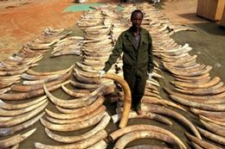
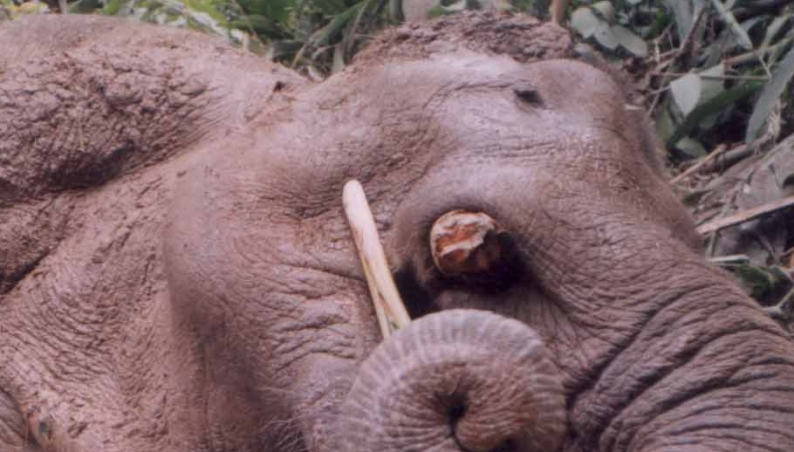
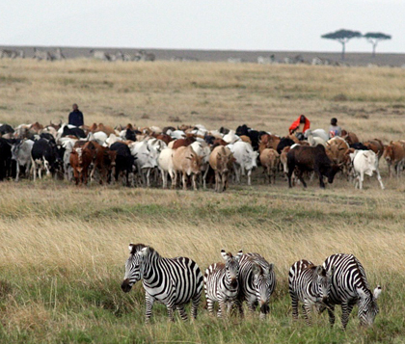
Threats to the Savanna(Cont.)

Slide 17
Protection for the Biome and You
National parks are being made in which there is no farming, poaching, or overgrazing.
Something we could do is not go on safaris. You could also donate to animal conservation groups.

Slide 18
Thank You for Watching
http://savannaca.weebly.com/

